Slide 1

ANALYSIS OF EUROPEAN FINANCIAL MARKET
Group members:
GAURAV GUL LALWANI
JASKIRAT SINGH
OMKAR PANDIT
SHWETA MANE
SONAKSHI GARG

Slide 2
INTRODUCTION
Know your scope to stand ahead in European Financial Market.
Get to know your competitors.
Beware of market crests and troughs.

Slide 3
PROBLEM STATEMENT
Regression
Turnover
Classification
Size of the firm
Gross Profit

Slide 4

DATA AVAILABLE
Sources
Amadeus - WRDS (Wharton Research Data Services)
Size/Scope
Approximately 400,000 data points

Slide 5

PREPROCESSING (Phase 1) - EXCEL
Selection of top 3 countries
Merging of data for these 3 countries
Removal of unwanted variables

Slide 6
PROBLEMS IN USING ALL PREDICTORS
Overfitting
High Variance Covered
Higher R²

Slide 7

PREPROCESSING (Phase 2) - PYTHON
Filtering Missing values, Outliers
Replacing missing values with mean
Inclusion of dummy variables
Dropping less significant variables

Slide 8
SELECTION OF VARIABLES
Correlation:
Obtained from the correlation function
Provides the relationship between predictors
Importance:
Obtained from the feature_importances_ function in Random Forest Classifier
Provides the impact of every variable on the response
Scaling and Normalizing

Slide 9
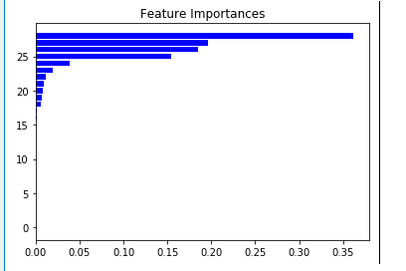
GROSS PROFIT
Shareholders funds(0.3615)
Financial expenses (0.1962)
Costs of goods sold (0.1847)
Current Liabilities: loans (0.1547)
Notes:
[(0.3615, 'Shareholders funds'), (0.1962, 'Financial expenses'), (0.1847, 'Costs of goods sold'), (0.1547, 'Current Liabilities: loans'), (0.0381, 'Other operating expenses'), (0.0189, 'Other operating expenses'), (0.0113, 'Taxation'), (0.0092, 'Tangible fixed assets'), (0.0081, 'Enterprise value'), (0.007, 'Current liabilities'), (0.0062, 'Other shareholders funds'), (0.0011, 'Shareholders funds'), (0.0008, 'Tangible fixed assets'), (0.0004, 'Working capital'), (0.0004, 'Total shareh. funds & liab.'), (0.0003, 'Current assets'), (0.0002, 'Net current assets'), (0.0002, 'Current Liabilities: creditors'), (0.0002, 'Costs of goods sold'), (0.0001, 'Shareholder funds: capital'), (0.0001, 'Other current assets'), (0.0001, 'Financial revenue'), (0.0001, 'Current assets: stocks'), (0.0001, 'Current assets: debtors'), (0.0, 'Total assets'), (0.0, 'Sales'), (0.0, 'Other fixed assets'), (0.0, 'Other fixed assets'), (0.0, 'Cash & cash equivalent')]

Slide 10
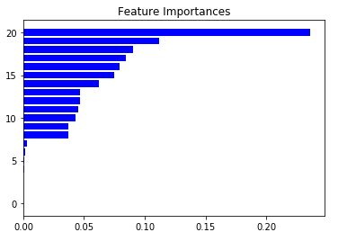
TURNOVER
Costs of goods sold (0.236)
Cash & cash equivalent (0.1116)
Current assets (0.089)
Other operating expenses (0.0845)
Other fixed assets (0.079)
Notes:
[(0.3615, 'Shareholders funds'), (0.1962, 'Financial expenses'), (0.1847, 'Costs of goods sold'), (0.1547, 'Current Liabilities: loans'), (0.0381, 'Other operating expenses'), (0.0189, 'Other operating expenses'), (0.0113, 'Taxation'), (0.0092, 'Tangible fixed assets'), (0.0081, 'Enterprise value'), (0.007, 'Current liabilities'), (0.0062, 'Other shareholders funds'), (0.0011, 'Shareholders funds'), (0.0008, 'Tangible fixed assets'), (0.0004, 'Working capital'), (0.0004, 'Total shareh. funds & liab.'), (0.0003, 'Current assets'), (0.0002, 'Net current assets'), (0.0002, 'Current Liabilities: creditors'), (0.0002, 'Costs of goods sold'), (0.0001, 'Shareholder funds: capital'), (0.0001, 'Other current assets'), (0.0001, 'Financial revenue'), (0.0001, 'Current assets: stocks'), (0.0001, 'Current assets: debtors'), (0.0, 'Total assets'), (0.0, 'Sales'), (0.0, 'Other fixed assets'), (0.0, 'Other fixed assets'), (0.0, 'Cash & cash equivalent')]

Slide 11
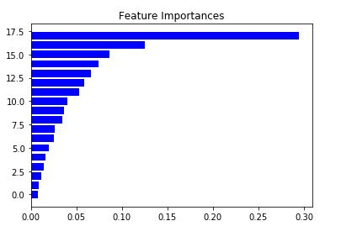
COMPANY CATEGORY
Intangible fixed assets (0.294)
Tangible fixed assets (0.124)
Current Assets (0.086)
Notes:
[(0.3615, 'Shareholders funds'), (0.1962, 'Financial expenses'), (0.1847, 'Costs of goods sold'), (0.1547, 'Current Liabilities: loans'), (0.0381, 'Other operating expenses'), (0.0189, 'Other operating expenses'), (0.0113, 'Taxation'), (0.0092, 'Tangible fixed assets'), (0.0081, 'Enterprise value'), (0.007, 'Current liabilities'), (0.0062, 'Other shareholders funds'), (0.0011, 'Shareholders funds'), (0.0008, 'Tangible fixed assets'), (0.0004, 'Working capital'), (0.0004, 'Total shareh. funds & liab.'), (0.0003, 'Current assets'), (0.0002, 'Net current assets'), (0.0002, 'Current Liabilities: creditors'), (0.0002, 'Costs of goods sold'), (0.0001, 'Shareholder funds: capital'), (0.0001, 'Other current assets'), (0.0001, 'Financial revenue'), (0.0001, 'Current assets: stocks'), (0.0001, 'Current assets: debtors'), (0.0, 'Total assets'), (0.0, 'Sales'), (0.0, 'Other fixed assets'), (0.0, 'Other fixed assets'), (0.0, 'Cash & cash equivalent')]

Slide 12
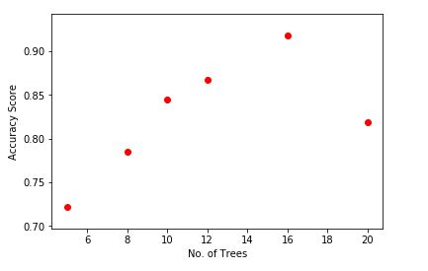
REGRESSION: OPERATING REVENUE/TURNOVER
 | Cross Validation Score
K- Nearest Neighbours | 0.78
Decision Tree | 0.32
Random Forest | 0.87

Slide 13
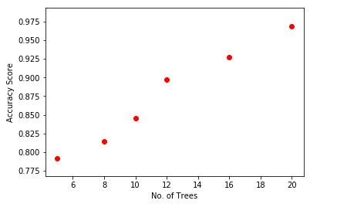
REGRESSION: GROSS PROFIT
 | Cross Validation Score
K- Nearest Neighbours | 0.69
Decision Tree | 0.7
Random Forest | 0.56

Slide 14
CLASSIFICATION: COMPANY CATEGORY
 | Cross Validation Score
K- Nearest Neighbours | 0.89
Decision Tree | 0.72
Random Forest | 0.98

Slide 15
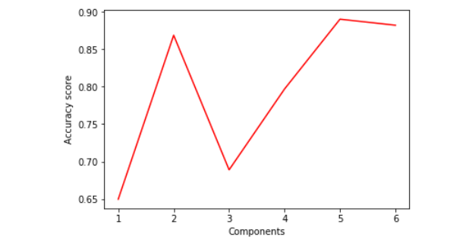
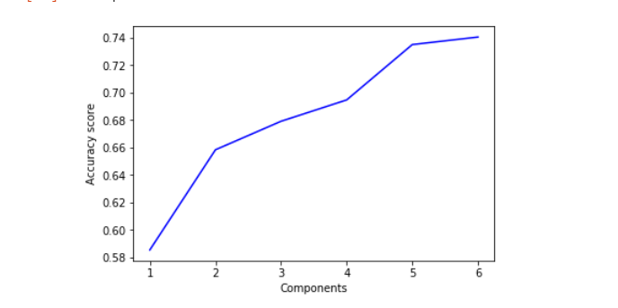
CLASSIFICATION: COMPANY CATEGORY
K-Nearest Neighbors Decision Tree Classifier

Slide 16
CONCLUSION
VARIABLES:
MORE FLEXIBILITY DOESN’T GAURANTEE HIGHER ACCURACY
MODELS
RANDOM FOREST MODEL TURNED OUT TO BE THE BEST OPTIMAL SOLUTION
METRICS
R SQUARE VALUES WERE HIGH BUT NOT HIGH ENOUGH TO OVERFIT
OUR MODELS COVERED THE MAXIMUM VARIANCE IN THE DATA USING MINIMUM PREDICTORS (PCA)

Slide 17


